Slide 1
What is it all about? Let´s explore OSIRIS project together!
Author:

Slide 2
About the OSIRIS project
Reproducibility is crucial to the progress and impact of Research and Innovation (R&I) as it confirms or corrects the outcomes of single studies, resulting in higher quality research, more reliable and implementable outcomes, and a reduction of research costs.
Embedding reproducibility in the strategy and design of research should thus be regarded as a key precondition to research quality.

Slide 3
Reasoning behind OSIRIS project
Unfortunately, only a fraction of published studies can be reproduced due to, e.g., science’s need to be continuously innovative, pressure to publish, a lack of transparent reporting, and career assessments based on quantity rather than quality.

Slide 4
Reasoning behind OSIRIS project
Currently, the burden of improving reproducibility lies with the researchers, as there are limited to no incentives to encourage active engagement in reproducibility and ideas for improvement have never been tested in practice.

Slide 5
What do we need and where is OSIRIS aiming?
We need a paradigm and culture shift to reform the R&I system both from the top down and the bottom up to regain overall trust in science.
Open Science to Increase Reproducibility In Science (OSIRIS) aims to facilitate this shift by systematically gathering knowledge on the underlying drivers, testing effective evidence-based solutions, identifying incentives for reproducibility by stakeholders, and embedding reproducibility in research design.
This will be realised by a unique team with hands-on expertise in Open Science (OS), reproducibility, implementation, and data sharing, along with a range of committed stakeholders that are closely involved through our Advisory Board (AB).

Slide 6
Objectives
To understand the underlying drivers and effective interventions that increase reproducibility at funding, publishing, university, and researcher-level
To develop and test effective, evidence-based solutions for the reproducibility crisis across various stakeholders in policy and research practice
To embed reproducibility in the strategy and design of research projects
To create a collaborative community of stakeholders that will aid in educating and implementing better reproducible research practice

Slide 7
Main methods applied
Systematic literature reviews, evidence mapping, policy audits, interviews, and focus group discussions with stakeholders
Randomised Controlled Trials, dashboards of indicators of reproducible research practices, and guidance for judging reproducibility
Informing researchers and convincing funders and journals to include measures and preconditions on reproducibility in their assessment of project proposals and articles
Using our results to create guidelines and training on how researchers can embed reproducibility in the design of their research; Quality audits at project and output level to test these novel practices

Slide 8
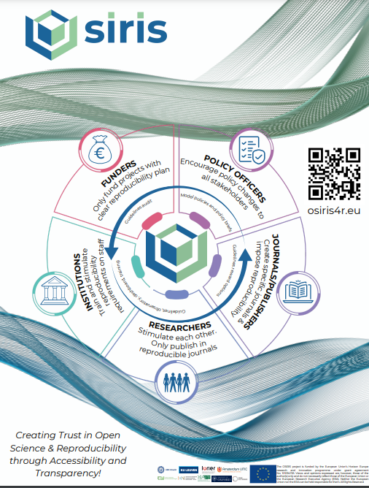
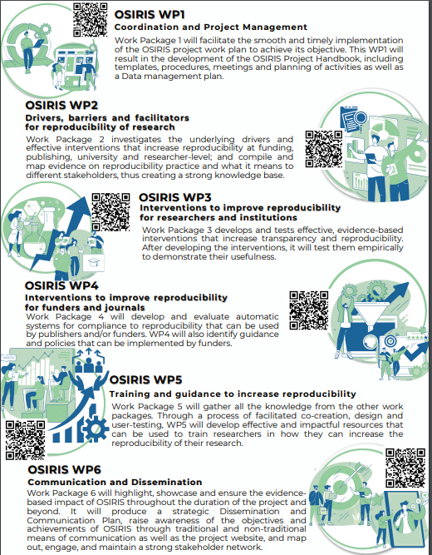
Want to know more? Here are our flyers!
Notes:
Here, I commonly suggest to distribute OSIRIS flyers – which can be downloaded from the Media center.

Slide 9
Where to find more about OSIRIS?
Website: https://osiris4r.eu/
Media Centre: https://osiris4r.eu/media-center/
Facebook: https://www.facebook.com/OSIRIS4R/
Twitter: https://twitter.com/osiris4r
Youtube: https://www.youtube.com/@osiris4r
LinkedIn: https://www.linkedin.com/company/osiris4r/

Slide 10
Thank you for your attention!

